Slide 1

General meeting 6/10 2022
Sjur Beyer

Slide 2
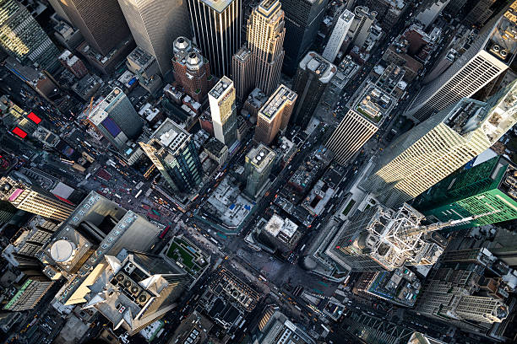
Overview
Updates on github
Runtime and compute
Plan going forward
Brief overview of dataset and considerations
Results from tinkering
Minor updates
Hardware
Next meeting

Slide 3
The Git environment
I changed from using OTokens to having a SSL based git connection. If you are added as a contributor, you should add a SSL key to your github account if you want to clone the repository.
Initially I planned to have the models saved in the repo. However, github limits the size of files to 100MB, which caused some issues…

Slide 4
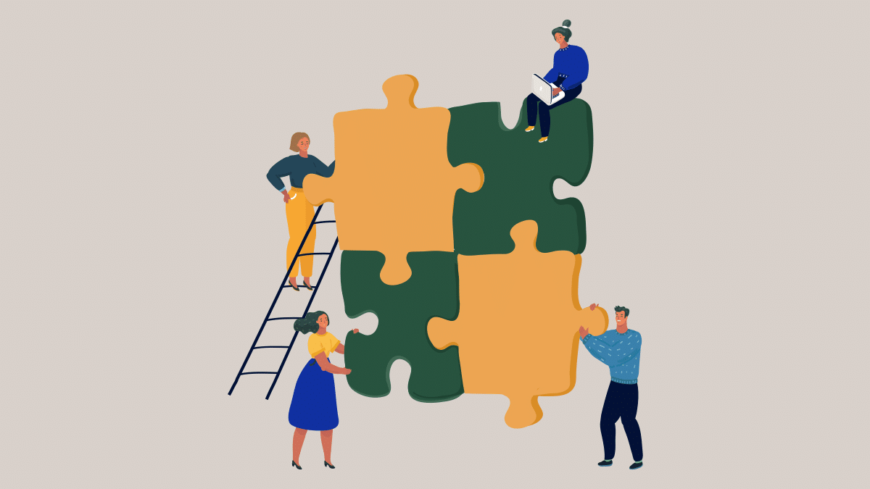
MS Teams
The current solution could be better..
I suggest that I set up mailing lists instead
Other suggestions?
Setting up a team on NGI teams system?

Slide 5
Current status for the models
I have ran some 1D reconstruction models;
Focusing on getting good procedures for running the models on the servers
Profiling:
I did not get very good results for running on Odin. My laptop performed better; Probably because keras ran things in parallel on the laptop graphics processor (much better parallel compute)

Slide 6

Plan going forward
Running models - meanwhile writing theory

Slide 7
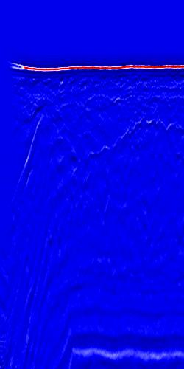
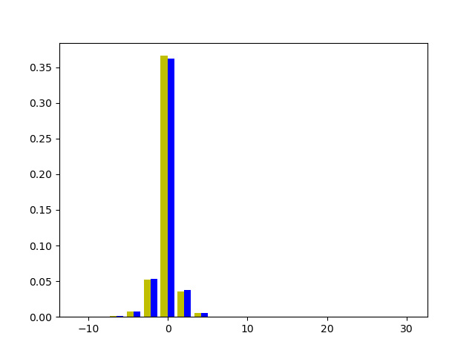
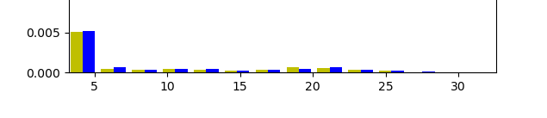
Data cleaning
The left-most side of the image contains some anomalous data which can distract the ML training
These traces should be removed from the data set
In this histogram the bins were set to be 20, yet only 6 of them are visible.
There are outliers in the dataset.
Yellow = predicted values
Blue = true values

Slide 8
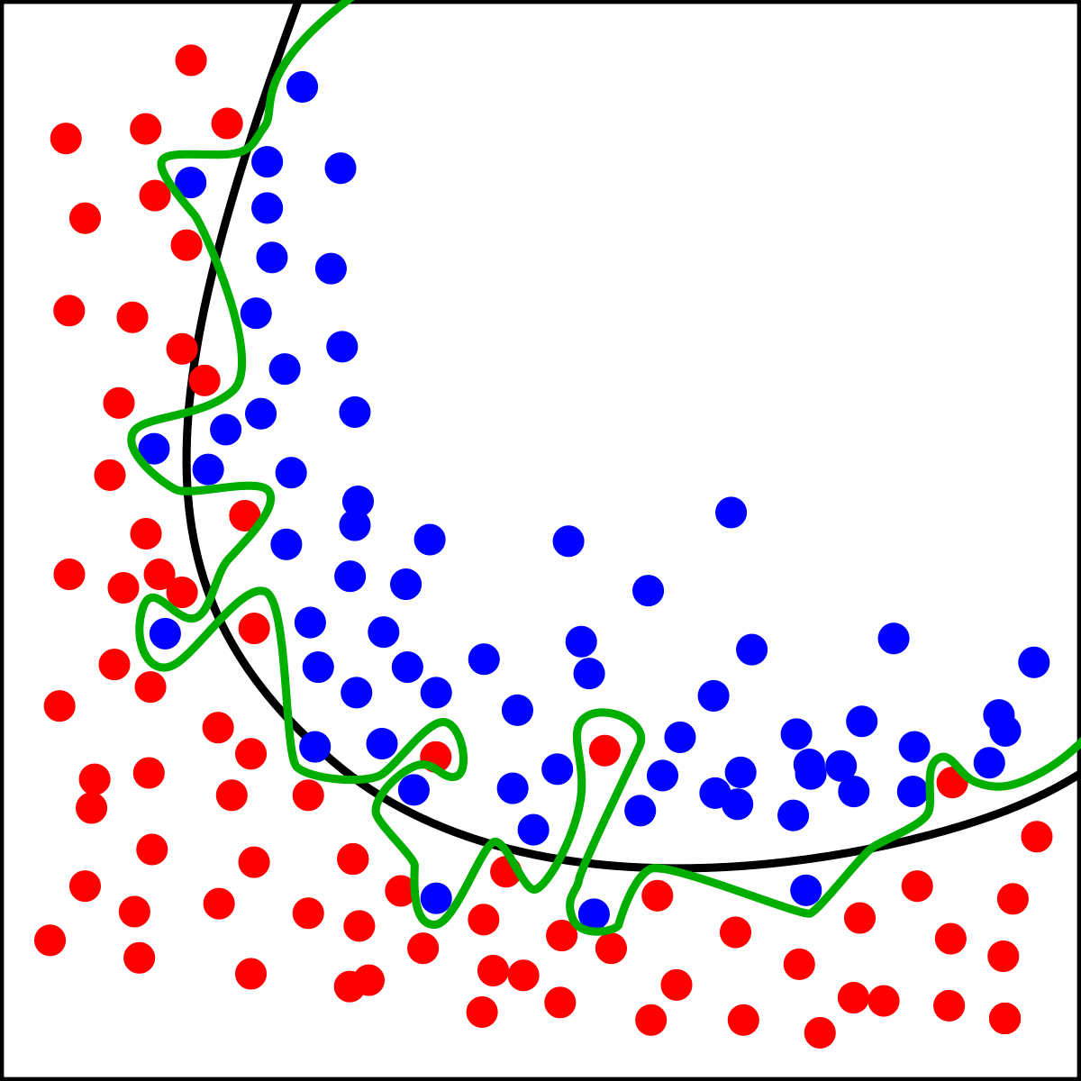
Preliminary experiments
Goal:
Try to overfit to reconstructing seismic, and explore which parameters are best for this task.
Afterwards it’s possible to generalize for good results. This method of working is recommended from a friend who is studying informatics with a ML specialization.

Slide 9
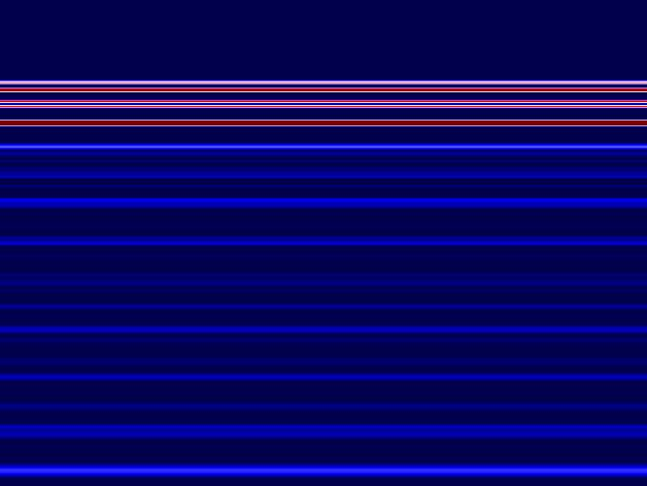
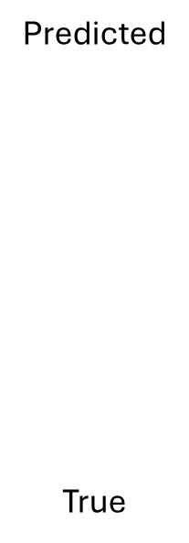
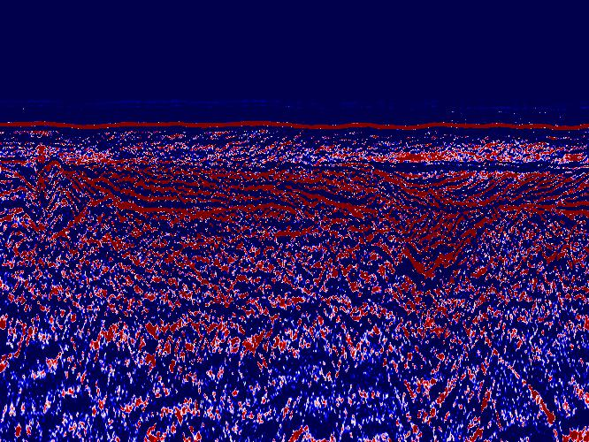
Initial results
Testing out reconstructing the seismic data with 1D TCN
Model converges to some sort of average
NB! These plots are not normalized
Config:
nb_filters = 64
Kernel size = 3 ( which may explain a lot)
Dilations = [1, 2, 4, 8, 16]
batch_size = 20
Epochs = 10
Loss approx. 3

Slide 10
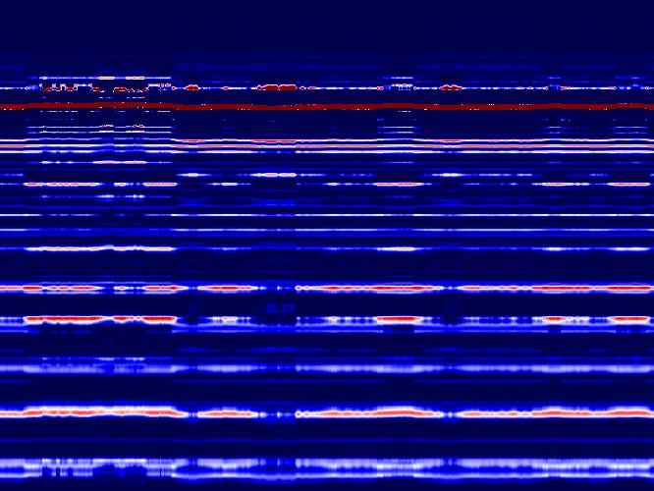
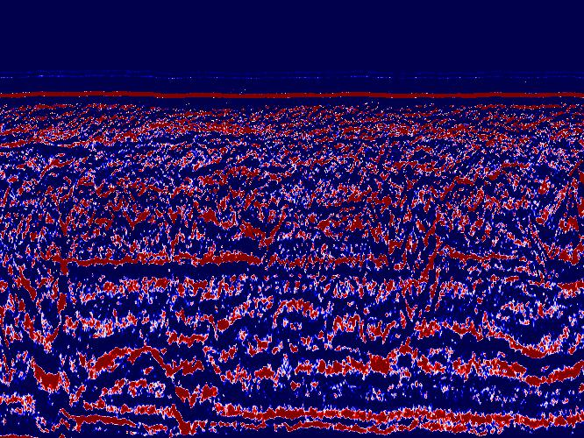
2nd try
This one was able to capture the ocean bottom reflector pretty well.
Config:
nb_filters = 64
Kernel size = 8
Dilations = [1, 2, 4, 8, 16, 32]
batch_size = 20
Epochs = 10
Loss = 1.28
Predicted
True

Slide 11
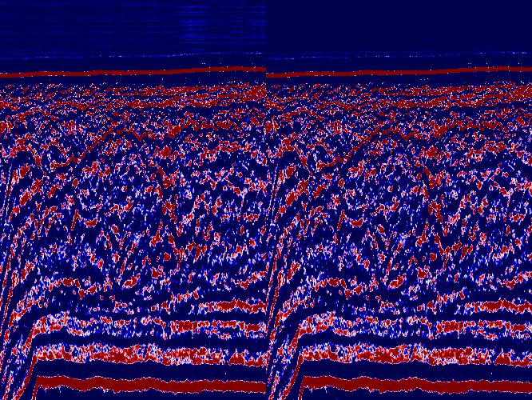
3rd try
Predicted
True
Config:
nb_filters = 128
Kernel size = 8
Dilations = [1, 2, 4, 8, 16, 32]
batch_size = 20
Epochs = 12
Loss ≈ 0.016
Runtime ≈ 2h

Slide 12
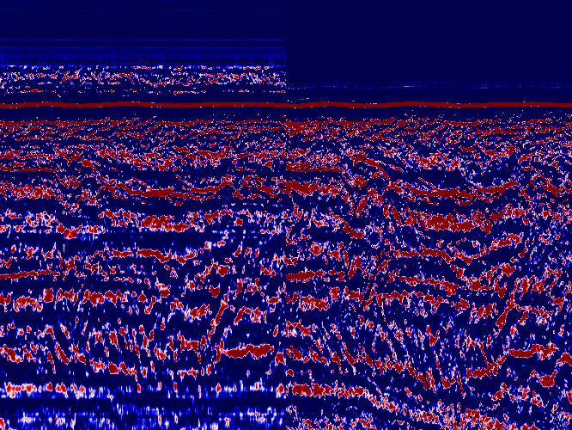
4th try
Predicted
True
Config:
nb_filters = 1
Kernel size = 8
Dilations = [1, 2, 4, 8, 16, 32]
batch_size = 20
Epochs = 12
Loss ≈ 0.4842
Runtime ≈ 31min

Slide 13
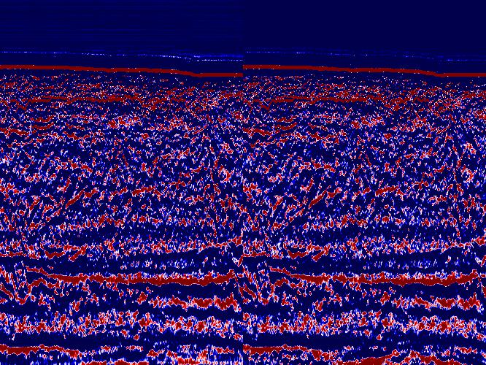
5th
Predicted
True
Config:
nb_filters = 2
Kernel size = 8
Dilations = [1, 2, 4, 8, 16, 32]
batch_size = 20
Epochs = 12
Loss ≈ 0.114
Runtime ≈ 35min

Slide 14

Optuna
To be continued…
Config:
nb_filters =
Kernel size =
Dilations =
batch_size =
Epochs =
Loss =

Slide 15
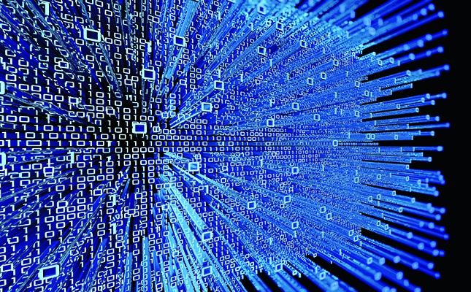
All of this is before any data preperation
Data prep will most likely improve results:
Removing outliers
Normalizing the data
I will investigate this until next meeting

Slide 16
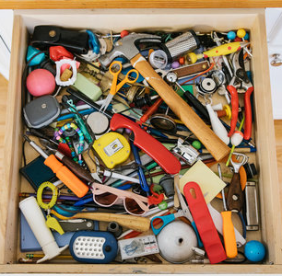
Misc
Still, a lot of code needs refinement..
Summary stats
In keras, you can add metrics (exploring this)
Saving input config
Config permutations
Custom loss functions
2D convolutions
Causal padding is not supported for Conv2D
Not supported for the keras function. Must review Mustafa, 2021 paper for this
I have also found his code, however he uses pyTorch
Prestack data in stead of poststack?
Poststack sacrifices information for better human comprehension

Slide 17
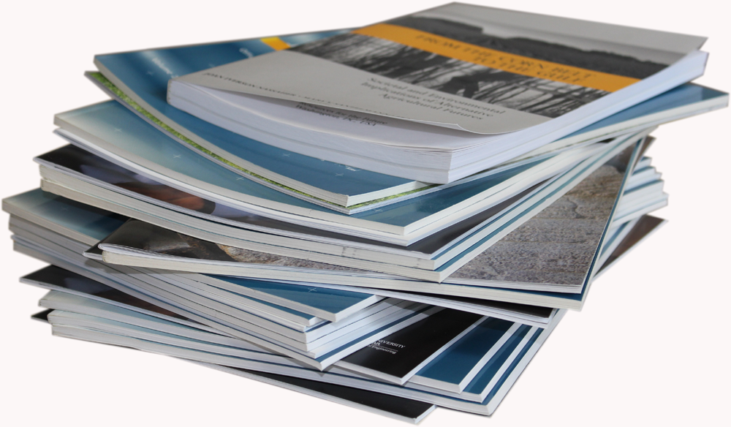
Academics and writing
I’m collecting good sources, and outlining the structure of what is to be written.
I’m planning to get a lot of writing in while the models are running.

Slide 18
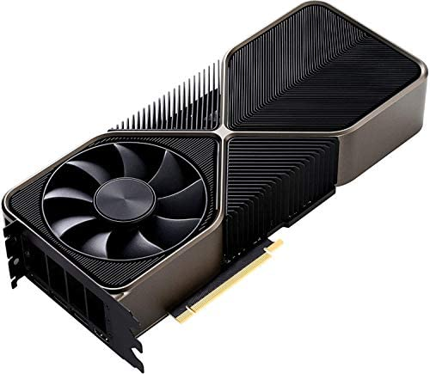
Hardware
More GPU power
Having a GPU hooked up to my NGI laptop would drastically speed up training time
CPU vs. GPU wrt. Odin
Azure cluster
Amazon Web services
$$$
Nvidia Gforce RTX 3090: 15 000 NOK
Razer eGPU: approx 4 000 NOK
Forum post: https://egpu.io/forums/builds/2020-12-5-lenovo-thinkpad-x280-intel-hd-620-8th-4-i7-8550u-pny-rtx-3090-xlr8-gddr6-24gb-32gbps-tb3-razer-core-x-ubuntu-20-04-lessse/

Slide 19
Next meeting
13.10.2022: Geotechnics & geophysics
Topics of discussion:
Parameters for prediction
Geotechnical parameters
Seismic attributes
Their relationships
Data treatment
Good sources (for citing and where to find them)
etc..

